Slide 1

COST
Set Theory and Venn Diagrams

Slide 2
Revision
Sample space and Event
Set operations-
Union
Intersection
Complement
Mutually Exclusive Events
Probability Definition

Slide 3
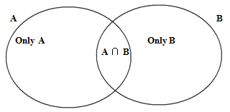
Inclusion Exclusion Principle
For two sets A and B
n (A ∪ B) = n(A) + n (B) - n (A∩ B)

Slide 4
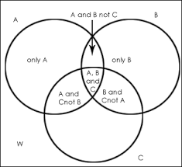
Inclusion Exclusion Principle
For 3 sets- A, B and C
n (A ∪ B ∪ C) = n(A) + n (B) + n(C) - n(A ∩ B) - n(B ∩ C) - n (C ∩ A) + n (A ∩ B ∩ C )

Slide 5
Question Nov 18
The data from a survey of 140 students showed that 37 study Music, 103 play a sport and 25 do neither. Create a Venn diagram to illustrate the data collected and then determine the probability that if a student is selected at random.
He or she will study music
b) He or she will study music given that he or she play sport
Solution-
Let set M- Students studying music
n(M) = 37
Set S- Students playing sports
n(S) = 103
Total Students N= 140
n(A U B) = 140 – 25 = 115

Slide 6
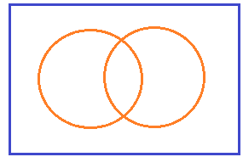
Cont..
140
Formula-
n (M ∪ S) = n(M) + n (S) - n (M ∩ S)
115 = 37 + 103 - n (M ∩ S)
n (M ∩ S) = 37 + 103 - 15
= 25
Students stydying only music= n(M)- n(M ∩ S)
= 37- 25
= 12
Students stydying only sports= n(S)- n(M ∩ S)
= 103 - 25
= 78
S
25
M
12
25
78
M ∩ S

Slide 7
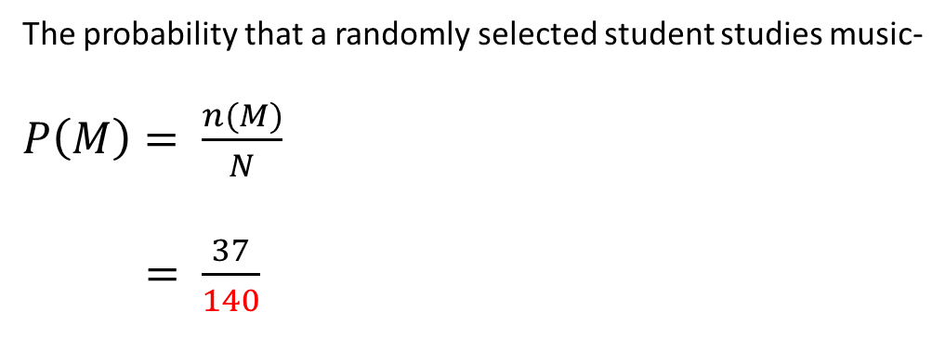
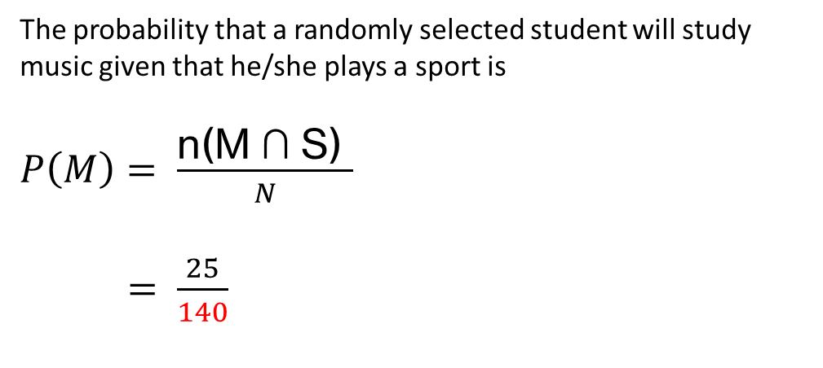
Cont..
140
The probability that a randomly selected student studies music-
$P\left(M\right)= \frac{n(M)}{N}$
$= \frac{37}{140}$
S
25
M
12
25
78
The probability that a randomly selected student will study music given that he/she plays a sport is
$P\left(M\right)= \frac{\text{n}\text{(}\text{M}\text{ ∩ }\text{S}\text{) }}{N}$
$= \frac{25}{140}$
M ∩ S

Slide 8
Question April 18
In a survey, 500 adults were asked the three-part question
(1) do you own a cell phone,
(2) do you own an ipod, and
(3) do you have an internet connection?
The results of the Survey were as follows (no one answered no to all three parts):
Cell phone 329, cell phone and ipod 83
Ipod 186, cell phone and internet connection 217
Internet connection 295, ipod and internet connection 63
How many adults have--
(I) answered yes to all three parts, (ii) had a cell phone but not an internet connection,
(iii) had an ipod but not a cell phone, (iv) had an internet connection but not an ipod,
(V) had a cell phone or an internet connection but not an ipod and, (vi) had a cell phone but Not an ipod or an internet connection.

Slide 9
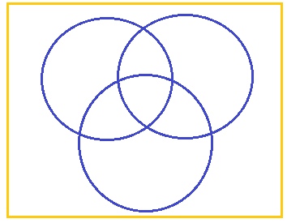
Solution
500
C
P
Only C
C and P not I
Only P
C ∩ P ∩ I
C and I not P
P and I not C
Set C- Cell phone users
Set P- Ipod users
Set I - internet users
N= 500
n(C) = 329
n( P) = 186
n( I ) = 295
Only I
I
n(C ∩ P) = 83
n( C ∩ I) = 217
n( P ∩ I) = 63

Slide 10
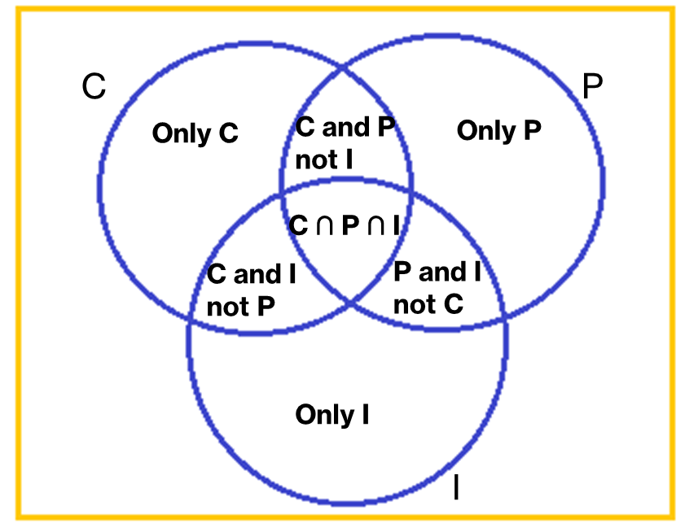
Cont…
Formula
n (C ∪ P ∪ I) = n(C) + n (P) + n(I) - n(C ∩ P) - n(C ∩ I) - n (P ∩ I) + n (C ∩ P ∩ I )
500 = 329 + 186 + 295 – 83 – 217 – 63 + n (C ∩ P ∩ I )
n (C ∩ P ∩ I ) = 53
n (C and P not I) = n( C ∩ P) - n (C ∩ P ∩ I ) = 83- 53= 30
n (C and I not P) = n( C ∩ I) - n (C ∩ P ∩ I ) = 217- 53= 164
n (P and I not C) = n( P ∩ I) - n (C ∩ P ∩ I ) = 63- 53= 10
n(only C) = 329- 30- 53- 164 = 82
n(only P) = 186- 30- 53 -10 = 93
n(only I) = 295 – 164 – 53 - 10 = 68
82
30
93
53
164
10
68

Slide 11
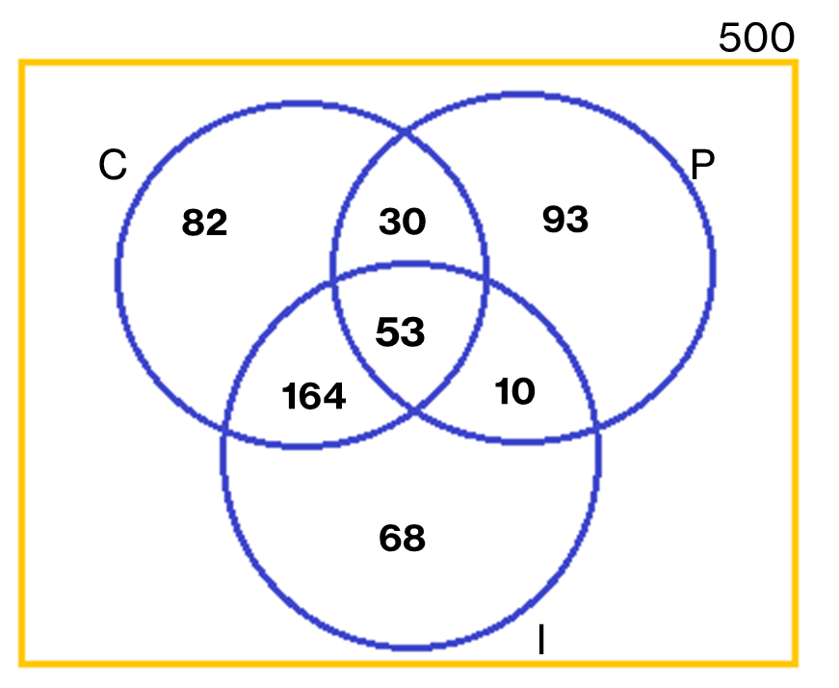
Cont..
answered yes to all three parts = 53
had a cell phone but not an internet connection
= 82 + 30 = 112
had an ipod but not a cell phone = 93 + 10 = 103
had an internet connection but not an ipod
= 68 + 164 = 232
had a cell phone or an internet connection but not an ipod
= 82 + 164 + 68 = 314
had a cell phone but Not an ipod or an internet connection
= 82

Slide 12
Question April 2019
A survey of 500 television viewers produced the following information: 285 watch football, 195 watch hockey, 115 watch basketball, 45 watch football and basketball, 70 watch football and hockey, 50 watch hockey and basketball, 50 do not watch any of the three games. Create a Venn diagram and then determine the probability that if the viewer is selected a random,
Watch all there games
Exactly one of the three games

